Slide 1

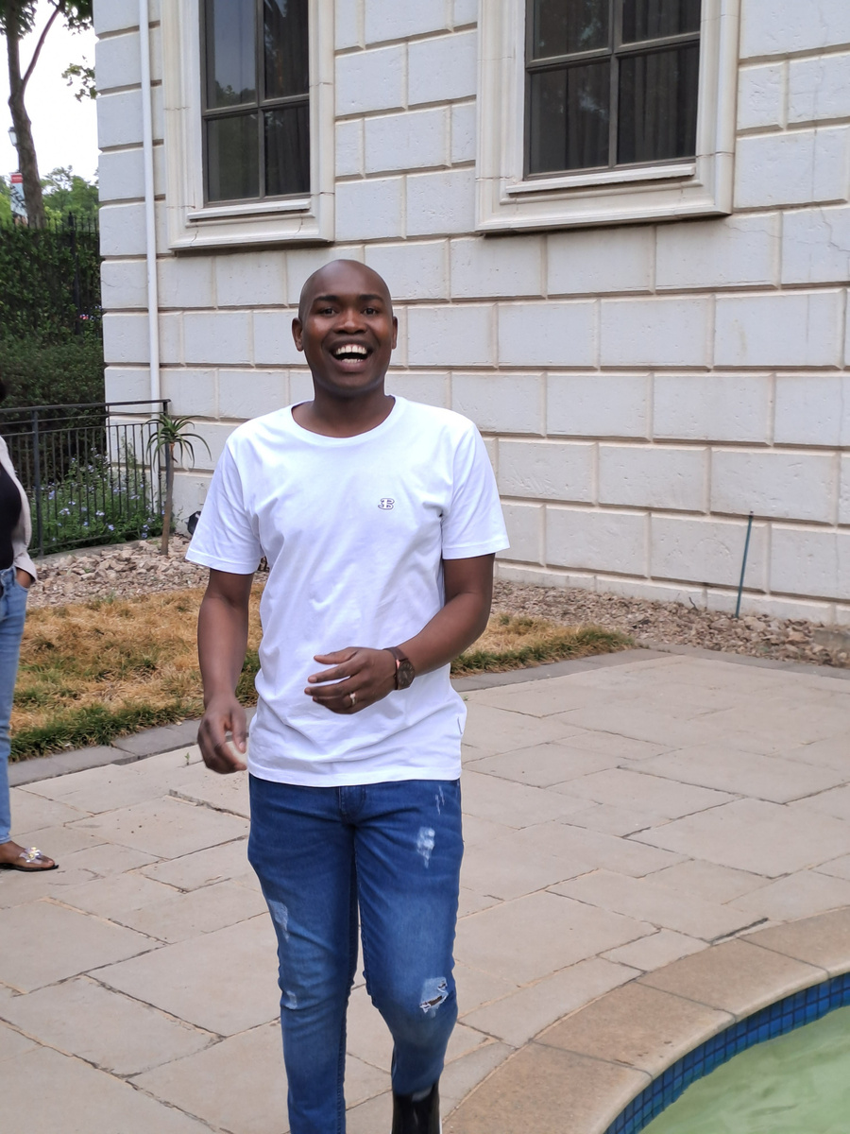
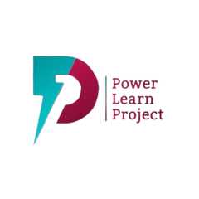
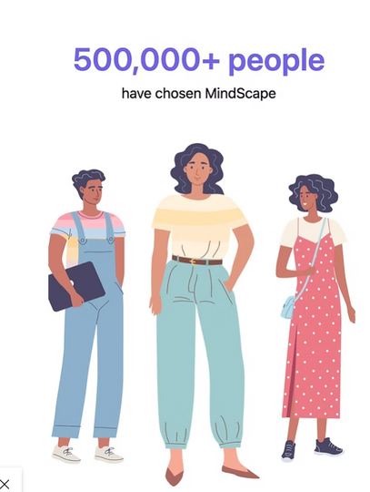
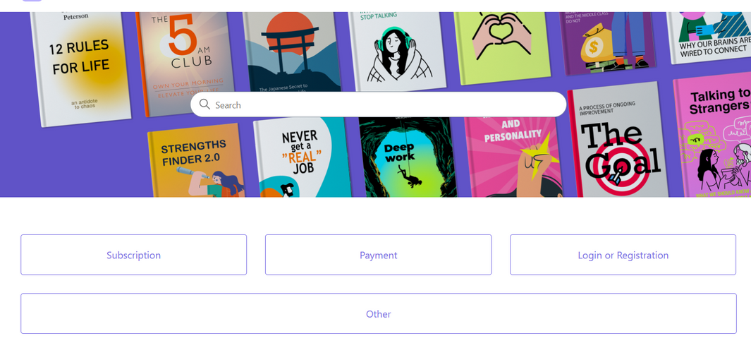
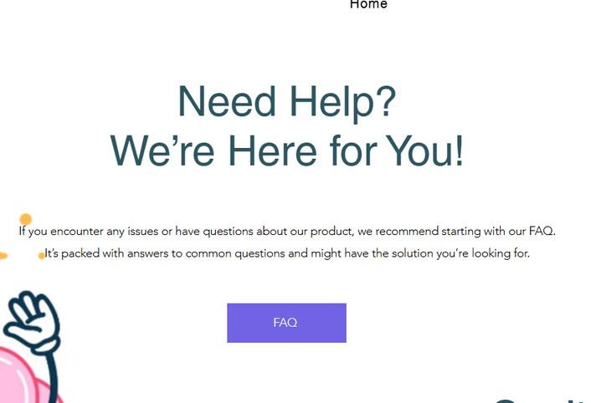
VIBE CODING HACK
MPHO MAPHALLE
what problem are you solving
https://www.mindscapeapp.io
Traditional therapy and psychology education often struggle with:
📉 Retention gaps: Clients forget strategies or lose momentum between appointments.
📚 Overwhelming content: Dense readings and resources aren’t built for quick digestion.
🔕 Limited therapist-client interaction between sessions due to time and compliance constraints.
🧠 Student disengagement from passive learning formats in academic settings.
Key Features
1
2
3
What solution do you have
App bridges these gaps with:
Microlearning: Short bursts of tailored content that match attention spans and busy schedules.
Therapist-guided digital reinforcement: Psychologists can personalize lesson flows to each client’s needs.
Self-awareness tools: Emotion trackers, prompts, and feedback loops empower active reflection.
Secure messaging + notes: Facilitates thoughtful communication without breaching privacy standards.
Why is you product better
welcome page
Make payment
FQA
🔥 MindScape isn’t just another wellness app—it’s a focused, intelligent bridge between education, therapy, and real-world reflection.

